Slide 1

3 Secrets to Successful PM Implementation
Presented by Jed DeGroote and Mike Stapleton
November 1st, 2011 2-3 pm EST
We will begin the webinar in just a few minutes. To ask questions throughout the webinar use the chat feature. We will review and answer questions submitted through the chat feature at the half way point and at the end of the webinar.
Thank you for attending!
For the audio portion of today’s webinar, dial 866-740-1260 and use the following access code: 7440763.

Slide 2
Introductions
Jed DeGroote- Success Operations Manager- SchoolDude.com
  Managing pro-active support efforts for SchoolDude.com
  Client Service Center 6+ years
Mike Stapleton- President/Owner- Service Management Assist
  Partner with SchoolDude for over 10 years
  Has helped implement over 180 SchoolDude clients

Slide 3



Benefits to PM
General life safety
Extending the life of the buildings and grounds
Increasing the productivity of faculty, administrators, students and operations and maintenance personnel
Notes:
Increasing the productivity of faculty, administrators, students and operations and maintenance personnel
Improving and maintaining the aesthetic qualities of the building and grounds
Identifying degradation of building elements that may otherwise be unnoticed
Ensuring compliance with current codes and standards
Reducing energy consumption to the lowest possible level

Slide 4
Is PM a Priority?
SchoolDude.com Preventive Maintenance Survey
As a facilities leader in your district, how important is a PM program in the scheme of your district's priorities (select one answer that most closely applies)?
Answer Options | Response Percent
Top 5 issue | 36.1%
Top 10 issue | 21.0%
Its important but I seem to never be able to give it the attention it needs | 41.0%
Its near the bottom | 2.3%

Slide 5
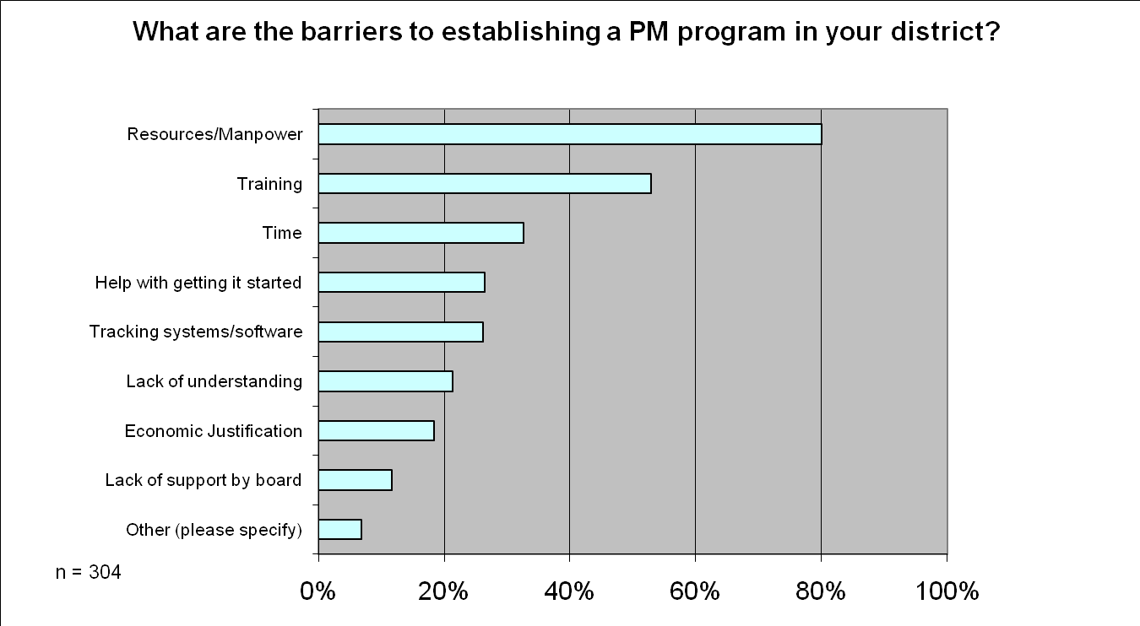
PM Challenges

Slide 6
Many Barriers to PM
Seems like there is never enough time
With growing fiscal concerns, a slowing economy and the rigorous day to day demands of your job, it’s likely that planned (preventive) maintenance in your district have been put on a back burner.
Vital but not urgent
But we know what you know: your district needs a sustainable plan for maintaining building equipment, grounds, etc.

Slide 7
The Increased Scope of Education Facility Management
Education Facility Managers are so over programmed that a complete program is rarely delivered
70’s,80’s,90’s,00’s & Now
1. Custodial operations
2. Maintenance operations
3. Grounds operations
4. Electrical / gas utility
5. Playground equipment
6. Pest control (in-house)
7. Roofs
8. Safety – general
9. School closings
10. Vandalism
11. Mold management
12. Asbestos (AHERA)
13. Carbon Dioxide testing
14. Lead in water
15. Natural gas volume purchasing
16. Electrical volume purchasing
17. CAD
18. CMMS with preventive maintenance
19. Electromagnetic emissions
20. Emergency / disaster plans
21. Energy management systems
22. Energy education
23. Data based custodial schedules
24. Rentals, community usage
25. ADA
26. Owners Construction Rep.
27. Indoor Air Quality
28. Lead in paint
29. Integrated Pest Management
30. Privatized custodial
40’s,50’s & 60’s
1. Custodial operations
2. Maintenance operations
3. Grounds operations
4. Electrical / gas utility
5. Pest control (in-house)
6. Playground equipment
7. Roofs
8. Safety – general
9. School closings
10. Vandalism
31. Purchased services management
32. Protective equipment & clothing
33. Radon Management
34. Recycle waste program
35. Re-locatable classrooms
36. Right to Know Act
37. Underground storage tanks
38. Computerization – technology support
39. Blood borne pathogens
40. Budget planning
41. Labor law issues
42. OSHA Logging & training
43. Custodial equipment management
44. Quality Assurance program
45. Hazardous Waste Removal
46. Emergency Backpacks
47. Building Backpack Supply
48. Defibrillator maintenance
49. Defibrillator training
50. Security systems
51. Green chemical management
52. Carbon footprint issues
53. Sustainability program
54. Life/Safety Planning
55. Playground management
56 . Expanded athletic programs
57. Swimming pool maintenance
58. Indoor track & field
59. Fertilization & weed control
60. Artificial athletic fields
Facility programs have increased dramatically but many institutions have smaller leadership teams

Slide 8
3 typical avenues to Successful PM Implementation
1. Do-it-yourselfers
SchoolDude starter templates and Quick Step Guides
SchoolDude Consultation
Unlimited one on one sessions for clients (training@schooldude.com)
3. Certified Partner Services
  Service Management Assist (SMA)

Slide 9
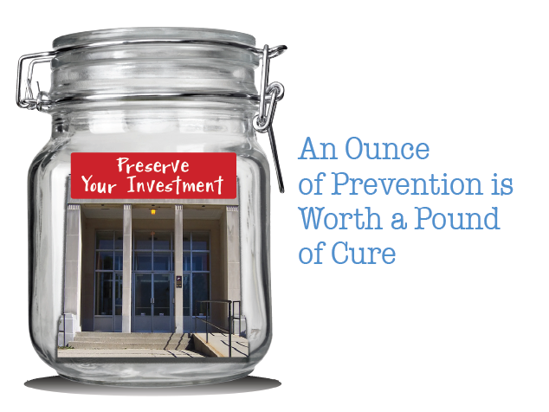
Secret One
  Get buy-in from decision makers
    Make them aware of the issues
    Show them cause and effect
    What’s the cost of not doing PM? (provide real examples)
    Leverage 3rd party information, studies, data
    AS&U
    SMA
    SchoolDude White Papers

Slide 10
Getting buy-in from decision makers
A strong PM Program reduces emergencies/catastrophic failures by more than 50%.
2-10 cents/sq/year in energy savings.

Slide 11
4 step process
Improve your image
Establish a respected methodology
Educate the decision makers and decision influencers
Present your request for more resources

Slide 12
Secret Two
  Create a culture of Planned Maintenance

Slide 13
Culture of Planned Maintenance
    Culture of Excellence
    Empower employees to pro-actively look for opportunities to take care of issues before they are reported
      Look for opportunities to fix something before it’s reported by an end user
      Add team based incentives
      Point of pride

Slide 14
Culture of Planned Maintenance
    Expect it to take time
Pick one type of PM to setup and concentrate on that first
Simply setup the recurring schedule and plan to add task lists at a later date.
Incremental Improvements

Slide 15
Culture of Planned Maintenance
    Expect it to take time
Pick one type of PM to setup and concentrate on that first
Simply setup the recurring schedule and plan to add task lists at a later date.
Incremental Improvements

Slide 16

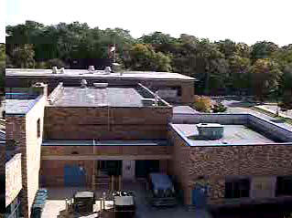
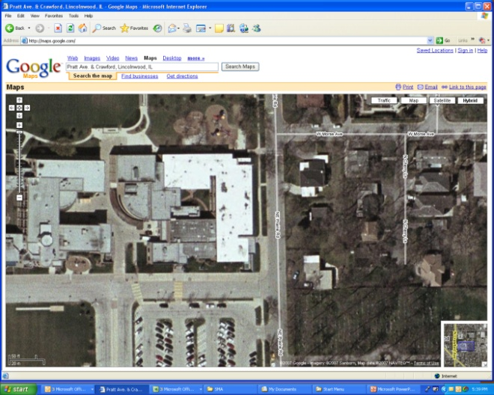
The Equipment Inventory Challenge
The essential equipment information entries needed to start a planned maintenance program are as follows:
1. Item #; 2. Equipment description; 3. Area location of the equipment; 4. Location (building) and 5. Filter / belt information related to the piece of equipment (existing lists of equipment, belts and filters are obtained to add to the list).
The first four listings allow the beginning of the planned maintenance scheduling. Many details like manufacturer, model and serial numbers are added by employees during the first cycle of planned maintenance work orders; these details are written on the work order and batched for entry by a clerical person.
The detailed equipment list may be obtained by physical tours of your buildings … most institutions suffer from sticker shock (70% more) when presented with a quote for these data gathering tours.
The most common sources of obtaining information for the equipment inventory:
Existing or old CMMS programs; existing hard copy equipment inventories; BAS equipment lists; blueprint tables and “as built” documents.
Internet conferencing interviews of key facility employees to form lists of equipment.
Have SMA train your employees to conduct physical inventories of equipment.

Slide 17
Data Collection and Data Integrity
Use staff to collect equipment data when performing routine work
Focus on key pieces of information
Leverage architectural drawings
Stagger Data collection process

Slide 18
Use your resources
Internal knowledge
SchoolDude consultations
SMA services
Secrets are available to everyone to have a successful PMDirect program

Slide 19
Contact Us
Jed DeGroote- jed@schooldude.com
www.schooldude.com/resources
Twitter- @schooldude
Mike Stapleton- mike@smaedu.com
http://smaedu.com/
Twitter- @SMA_Mike

